Slide 1



THE ISLAMIC PRINCIPLES PERTAINING TO LAWFUL (HELAL) AND PROHIBITED (HARAM)

Slide 2
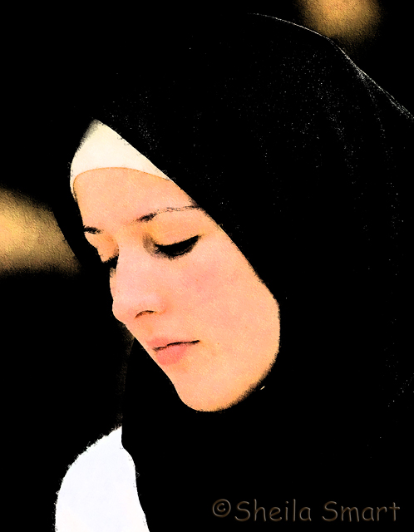
Clothing and Adornment

Slide 3
Cleanliness and Beautification
"Cleanse yourself, for Islam is cleanliness." (Reported by Ibn Hayyan.)
"Does he have nothing with which to comb his hair?" (Reported by Abu Daoud.)
Gold and Pure Silk are prohibited for Men while permitted for women
Islam must safeguard the manly qualities of men
the love of jewelry and ornaments is quite natural and becoming for a woman

Slide 4
The Dress of the Muslim man
Covering from belly button to knees
"Be different from the polytheists: let the beard grow and trim the moustache." hadith
The Dress of the Muslim Woman
Covering from head to toe
clothes which fail to cover the body
which are transparent, revealing what is underneath.
tightly fitting clothes which delineate the parts of the body

Slide 5
Concerning woman's imitating man and vice versa
“The Prophet (pbuh) declared that a woman should not wear a man's clothing nor a man a woman's. He cursed men who imitate women and women who imitate men.” (Hadith)
Aspects of such imitation include the manner of speaking, walking, dressing, moving and so on.
The prohibition of tattooing, cutting the teeth, and undergoing surgery for beautification
Do not change God’s creation

Slide 6
WORK AND BUSINESS TRANSACTIONS

Slide 7
Ahadith about work
The obligation to work if one is able
"Charity is lawful neither for the rich nor for the able bodied." (Hadith)
It is better that a person should take a rope and bring a bundle of wood on his back to sell so that Allah may preserve his honor, than that he should beg from people, (regardless of) whether they give to him or refuse him. (Hadith)
Beneficial works for God’s creatures
When a Muslim plants a plant or cultivates a crop, no bird or human being eats from it without its being accounted as a (rewardable) charity for him. (Hadith)

Slide 8
Work
Industries and professions condemned by Islam
Prostitution, Erotic Arts, Manufacturing Intoxicants and Drugs, Interest / usury
'Allah will punish anyone who makes figures until he breathes spirit into them, which he can never do.‘ (Hadith)
Responsibilities in regard to work
“Woe to the rulers, the leaders, and the trustees! On the Day of Resurrection some people will wish that they could be suspended between heaven and earth rather than having had the burden of their responsibilities.” Hadith

Slide 9
BUSINESS TRANSACTIONS
The Prohibition of Selling Forbidden Goods
The Prohibition of a Sale Involving Uncertainty
Price Manipulation
“Allah is the One Who fixes prices, Who withholds, Who gives lavishly, and Who provides, and I hope that when I meet Him none of you will have a claim against me for any injustice with regard to blood or property.” (Hadith.)

Slide 10
Business Transactions
The Condemnation of Hoarding
"If anyone withholds grain for forty days out of the desire for a high price, Allah will renounce him." (Reported by Ahmad, al-Hakim, Ibn Abu Shaybah, and al-Bazzar.)
The Permissibility of Brokerage
Exploitation and Fraud
"He Who Deceives Us Is Not of Us" hadith
Frequent Swearing
"Swearing produces a ready sale but blots out the blessing." (Reported by al-Bukhari.)

Slide 11
Business Transactions
The Prohibition of Usury/ Interest
“O you who believe, fear Allah and give up what remains due to you of interest if you are indeed Believers. And if you do not, then be warned of war (against you) by Allah and His Messenger, while if you repent you shall have your capital. Do not do wrong and you shall not be wronged.” (The Qur’an 2:278-279)
The taking of interest implies appropriating another person's property without giving him anything in exchange
Dependence on interest prevents people from working to earn money,

Slide 12
The Physical Appetites
Adultery
“..do not come near adultery; indeed, it is an abomination and an evil way (17:32),
Privacy
Islam prohibits Privacy denoting a man and woman's being alone together in a place in which there is no fear of intrusion by anyone else
Looking With Desire at the Opposite Sex
“Tell the believing men that they should lower their gazes and guard their sexual organs; that is purer for them. Indeed, Allah is well-acquainted with what they do. And tell the believing women that they should lower their gazes and guard their sexual organs, and not display their adornment, except that which is apparent of it…”

Slide 13
Man to man, woman to woman
“A man should not look at the private organs of another man, nor a woman of a woman, nor should a man go under one cloth with another man, nor a woman with another woman..” (Hadith)
Homosexuality
“What! Of all creatures, do you approach males and leave the spouses whom your Lord has created for you? Indeed, you are people transgressing (all limits)!” (26: 165-166)

Slide 14

Marriage

Slide 15
No Monasticism
“People before you perished because of their asceticism; they made excessive demands on themselves until Allah brought hardships on them: you can still see a few of them remaining in monasteries and temples..." (Hadith)
Prohibited Proposals
“A man must not propose to another man's betrothed unless he withdraws or gives him permission.” (Hadith)

Slide 16
Women To Whom Marriage is Prohibited
The father's wife, whether divorced or widowed.
The mother, including the grandmothers on both sides.
The daughter, including the granddaughters from the son or daughter.
The sister, including the half, and step-sisters.
The paternal aunt, whether she is the real, half, or step-sister of the father.
The maternal aunt, whether she is the real, half, or step-sister of the father.
The brother's daughter, i.e., his niece.
The sister's daughter, i.e., his niece.

Slide 17
Women To Whom Marriage is allowed
Marriage to the Women of the People of the Book is lawful
Polygamy
“If ye fear that ye shall not be able to deal justly with the orphans, Marry women of your choice, Two or three or four; but if ye fear that ye shall not be able to deal justly (with them), then only one…” (4/3)
“And you will not be able to do justice among (your) wives, however much you may wish to. But do not turn away (from one of them) altogether...”(4:139)

